Slide 1
Intro to AI and Machine Learning in Python
Dr. Steven Dinger
October 12th, 2021

Slide 2
Data Mining – the process of finding trends and patterns in large data sets
Machine Learning – the algorithms and methods used to perform data mining
Artificial Intelligence – the approximation of human intelligence using a computer

Slide 3
AI
Data Mining
Machine Learning

Slide 4
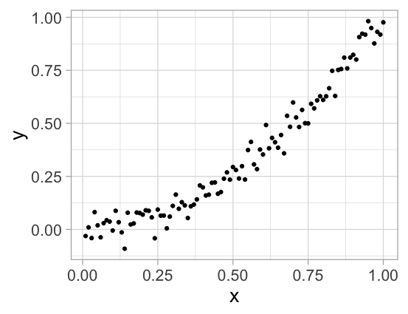

Slide 5
 | Statistics | Machine Learning

Slide 6
 | Statistics | Machine Learning
Age | ~120 years | ~20 years

Slide 7
 | Statistics | Machine Learning
Age | ~120 years | ~20 years
# Samples | 10s - 1,000s | 100s - Millions

Slide 8
 | Statistics | Machine Learning
Age | ~120 years | ~20 years
# Samples | 10s - 1,000s | 100s - Millions
Process | Hypothesis First | Data-Driven

Slide 9
 | Statistics | Machine Learning
Age | ~120 years | ~20 years
# Samples | 10s - 1,000s | 100s - Millions
Process | Hypothesis First | Data-Driven
Testing | Probability-Based | Holdout Samples

Slide 10
 | Statistics | Machine Learning
Age | ~120 years | ~20 years
# Samples | 10s - 1,000s | 100s - Millions
Process | Hypothesis First | Data-Driven
Testing | Probability-Based | Holdout Samples
Focus | Understanding “Why?” | Accurate Predictions

Slide 11
Housing Example
Bedrooms | Bathrooms | Area (Sq Ft) | Built | Location | Price
5 | 2 | 2418 | 1920 | Urban | $775,000
2 | 1 | 1115 | 1910 | Urban | $399,000
4 | 3 | 1859 | 1979 | Suburban | $300,000
3 | 3 | 2177 | 2017 | Suburban | $400,000
3 | 1 | 1075 | 1968 | Rural | $219,000
3 | 3 | 2815 | 1993 | Rural | $530,000

Slide 12
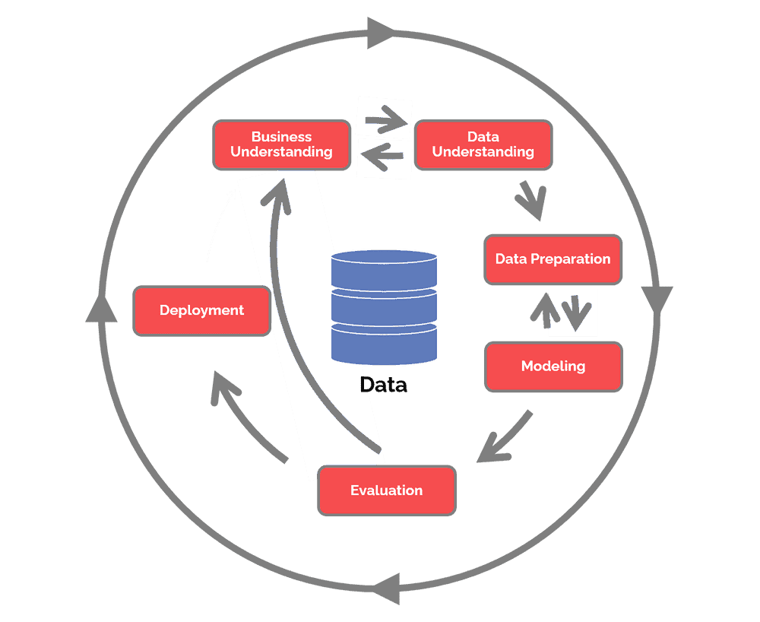
CRISP-DM

Slide 14
Descriptive Analytics
California Housing
github.com/sdinger/ElonDataCamp

Slide 15
Descriptive Analytics
Boston Housing Data
How many data points are there? Are there any missing values?
What is the mean, min and max of ‘PRICE’?
What variable correlates the most with ‘PRICE’?

Slide 16
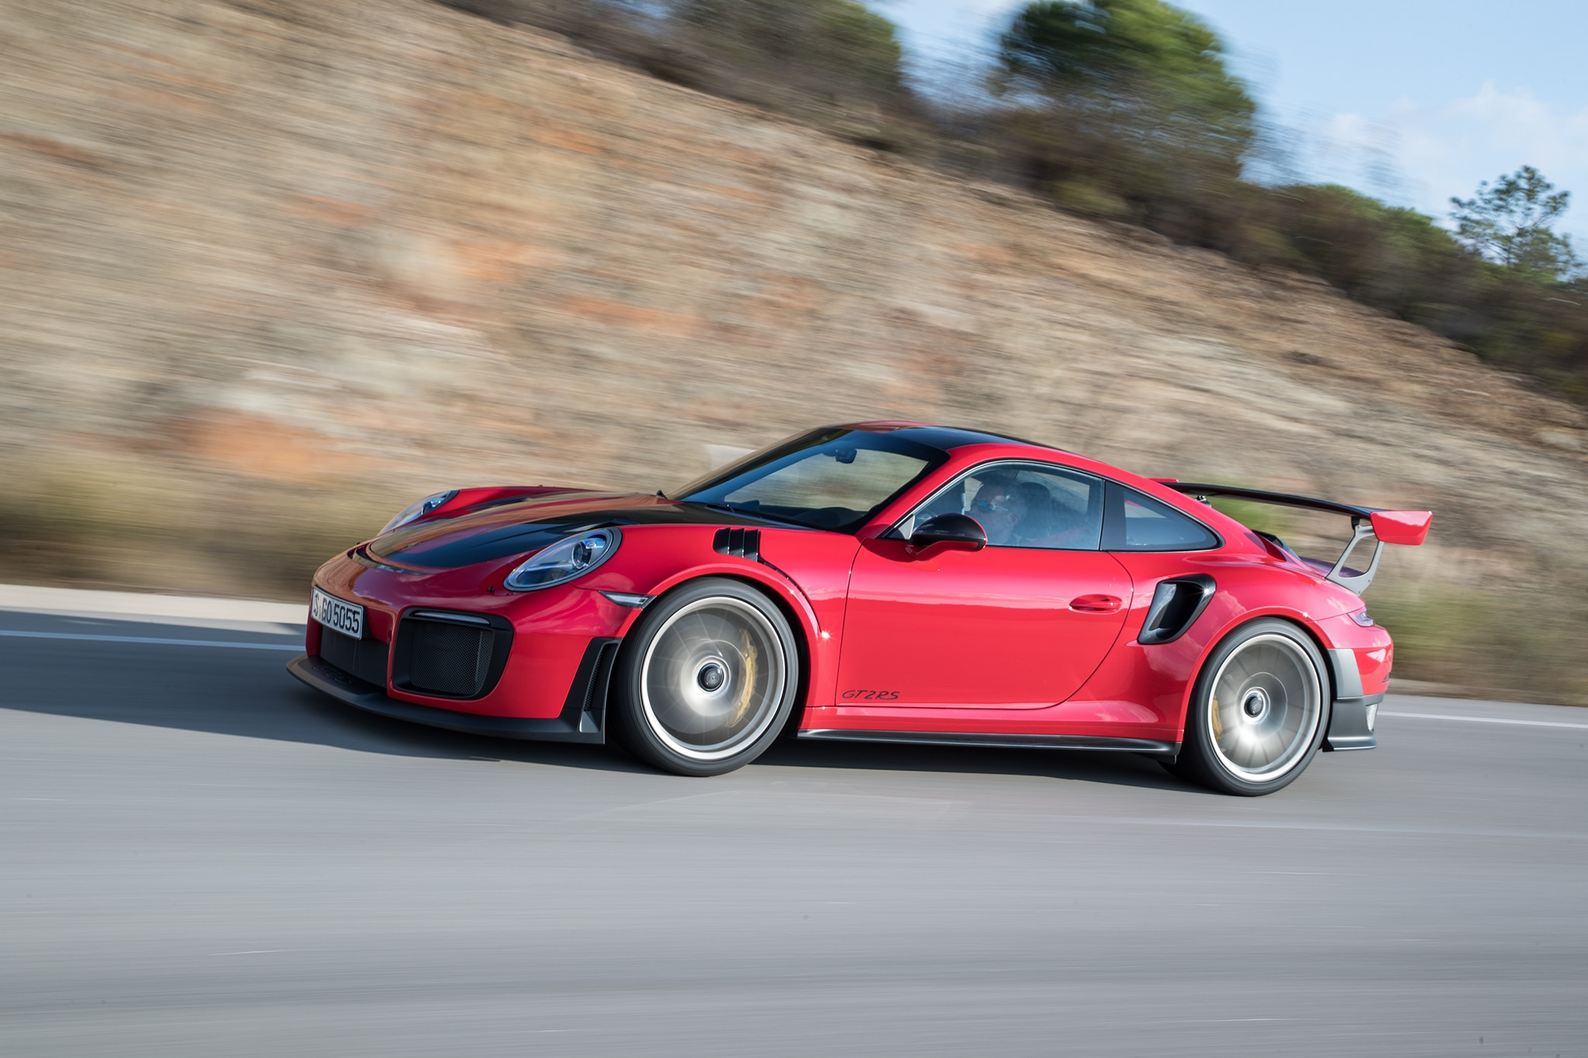
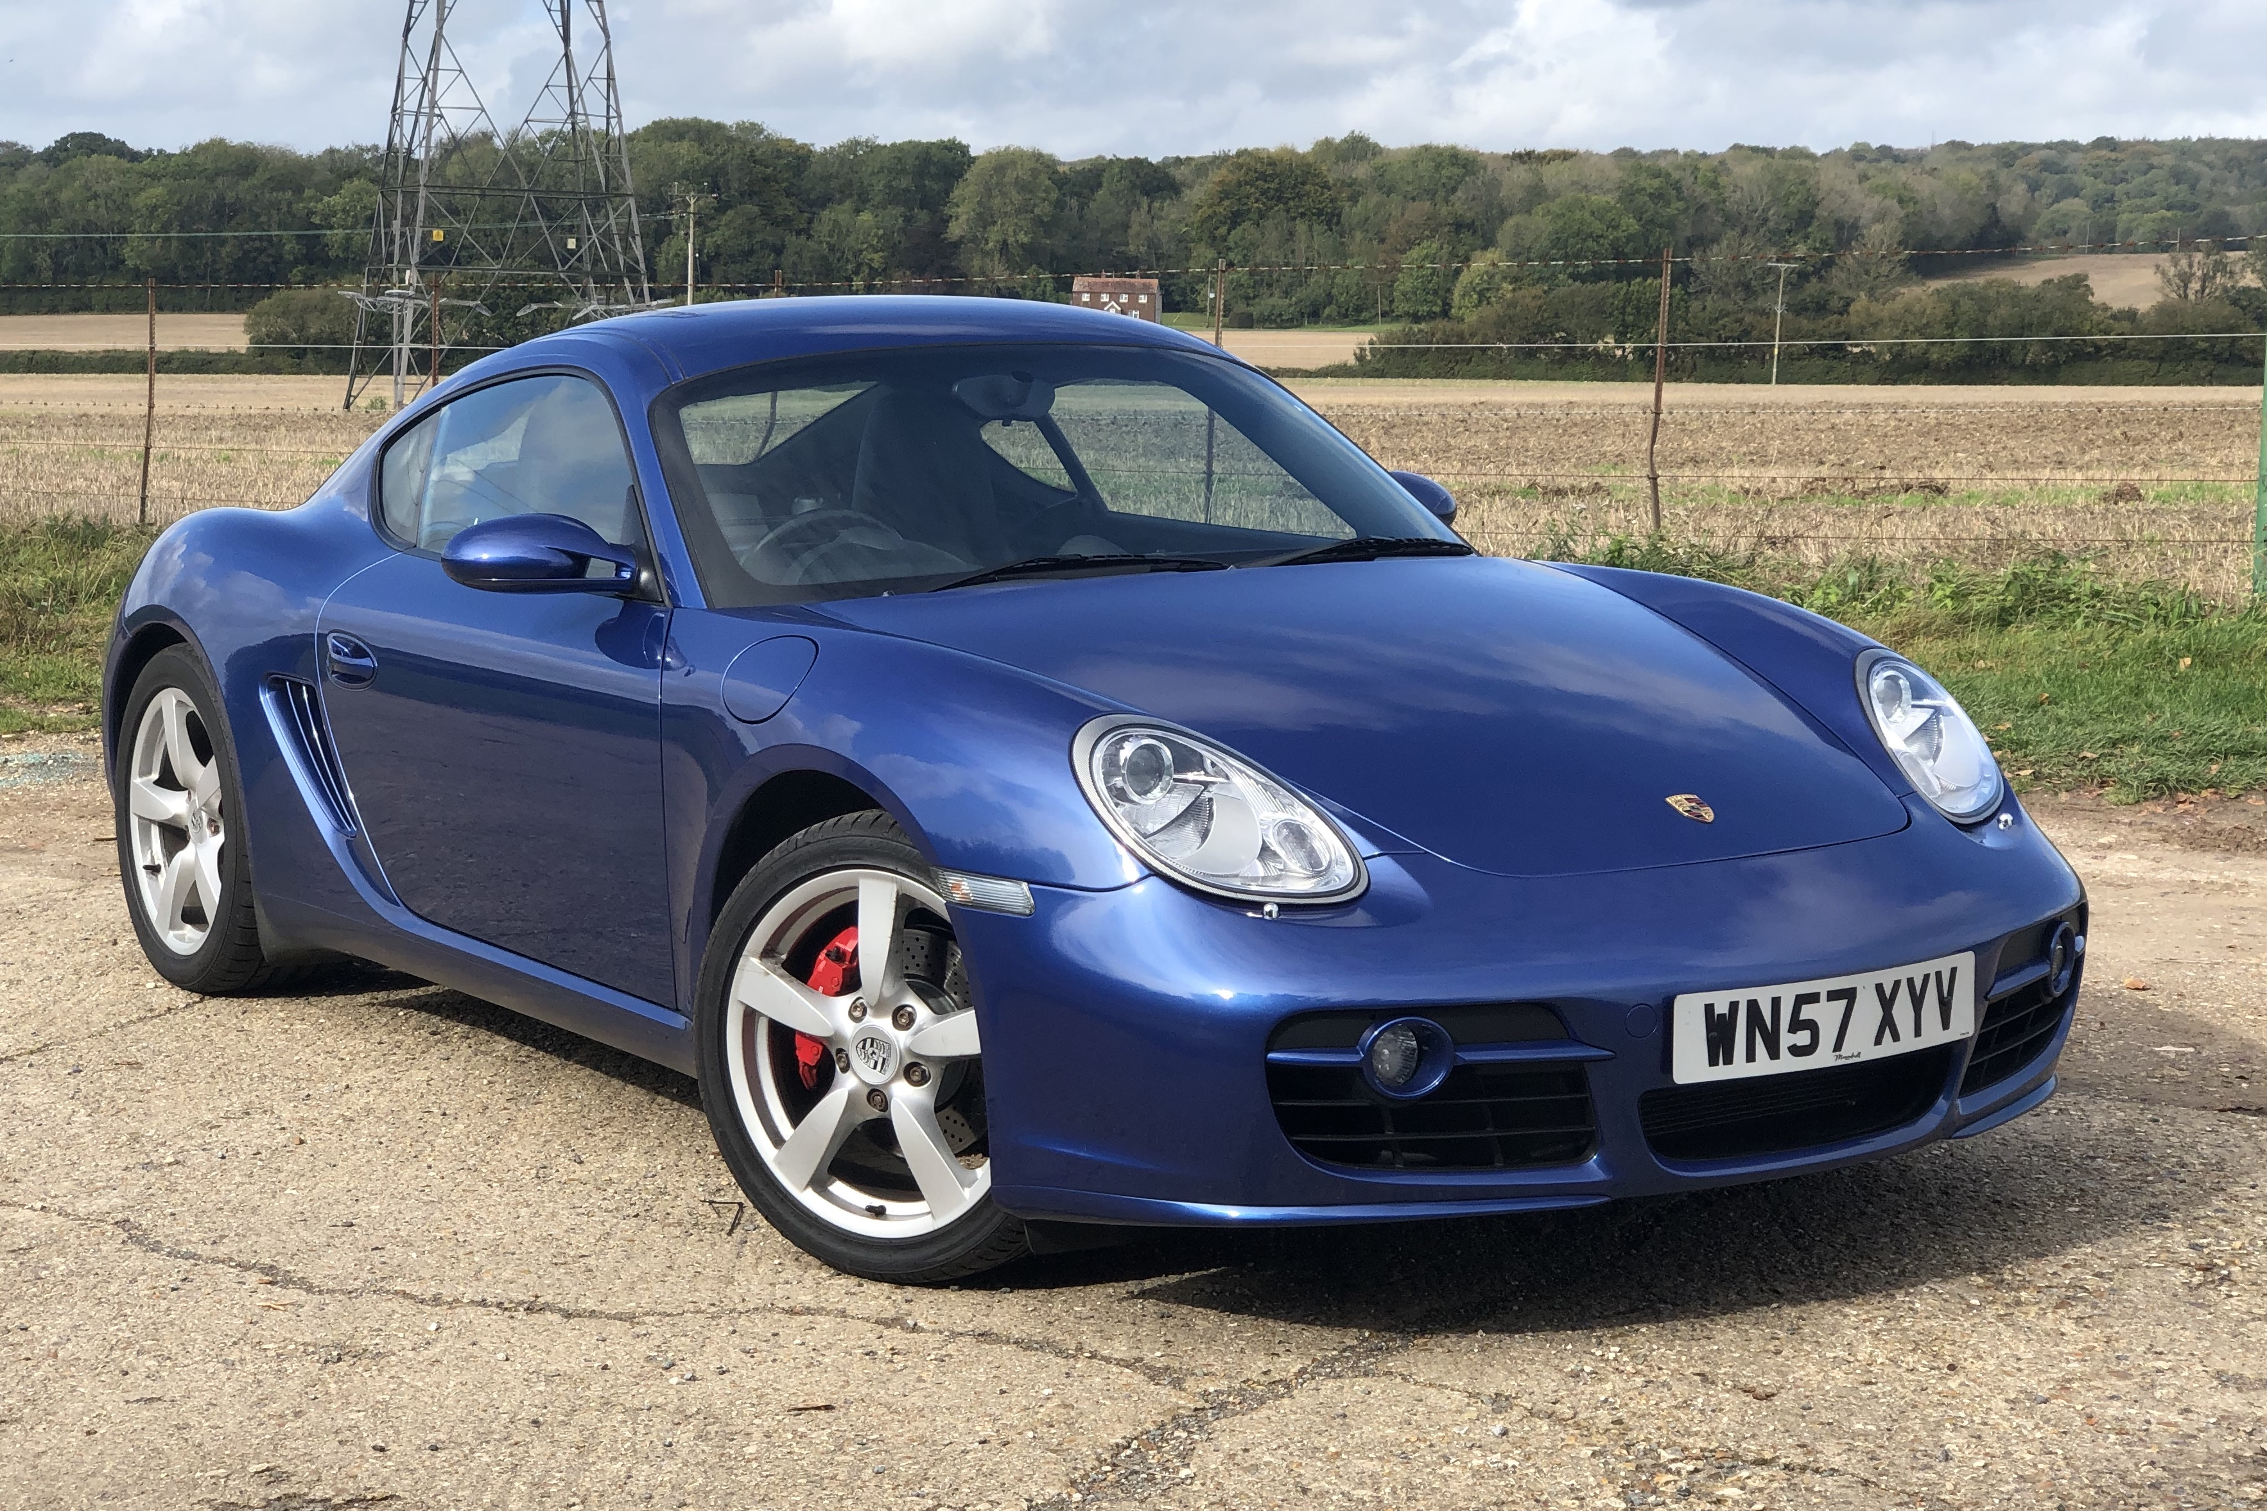
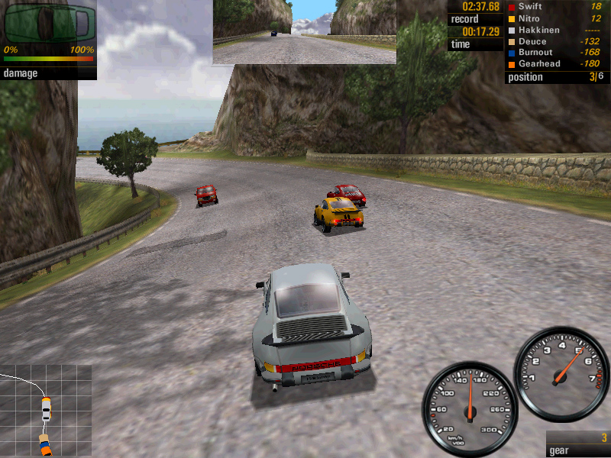
Types of Machine Learning
Unsupervised Learning
Supervised Learning
Reinforcement Learning
CAR

Slide 17
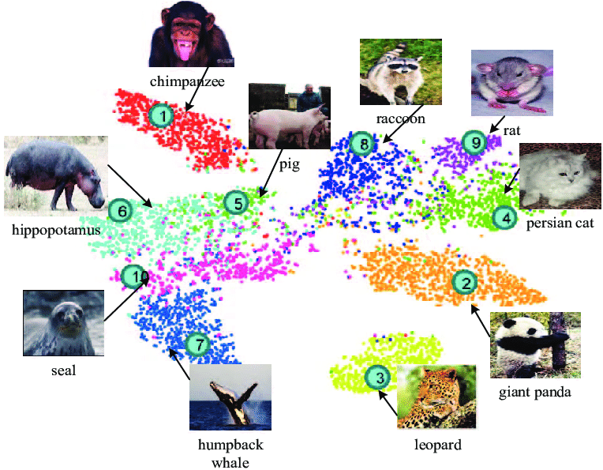
Unsupervised Learning
Does not use labels
Data Exploration
Data Reduction
Similarity (Clustering)

Slide 18
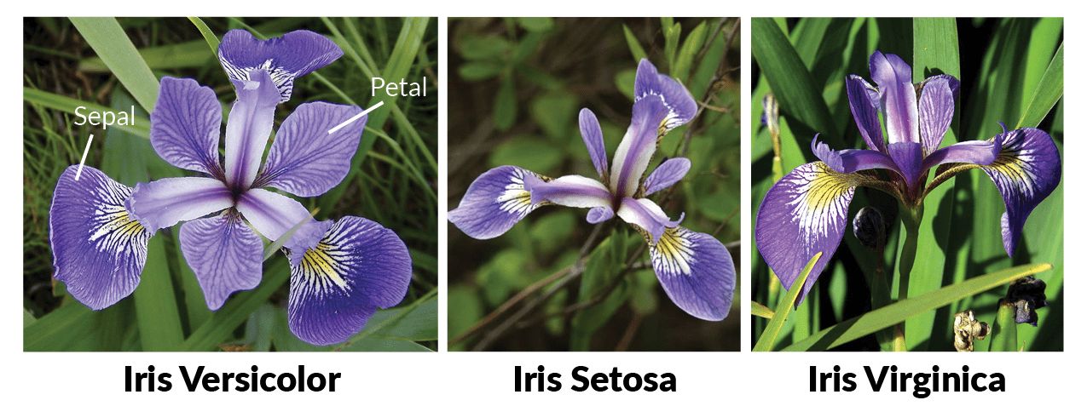
Iris Data Set

Slide 19
Clustering Example
Iris
California Housing
Drop bad data

Slide 20
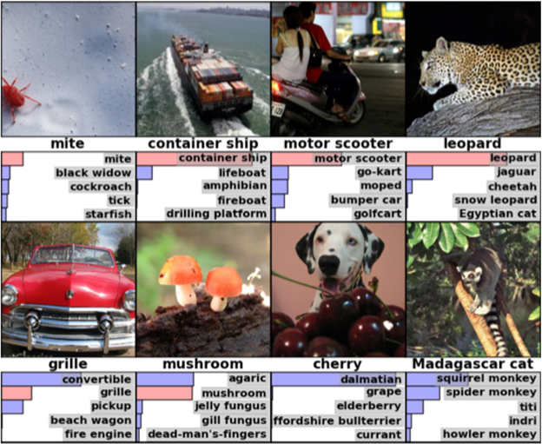
Supervised Learning
Predictive Analytics
Predict the label
Needs labeled training data

Slide 21
Types of Prediction
Classification
Distinct Categories
Sunny/Rainy
Species
Country
Residential/Commercial
Regression
Numeric Value
Temp, Pressure
Length, Weight, Age
Latitude, Longitude
Price

Slide 22
Iris Data Set
Now with labels!
Class Labels
Versicolor
Setosa
Virginica

Slide 23
Model Fit
Is this a good model?

Slide 24
Model Fit
Is this a good model?

Slide 25
Model Fit
How do we know if this is a good model?

Slide 26
Holdout Testing

Slide 27
Training/Testing Data
Randomly split the data
Training Data
Testing Data
Iris Dataset

Slide 28
Training/Testing Data
Breast Cancer Dataset
Split the data into training and testing sets
Train a Decision Tree Classifier
What is the accuracy on the testing data?
Repeat the above for a Random Forest Classifier

Slide 29
Neural Networks
Hidden Layer
Input Layer
w
Output Layer
Petal Length
w
Versicolor
Petal Width
Setosa
Sepal Length
Virginica
Sepal Width

Slide 30
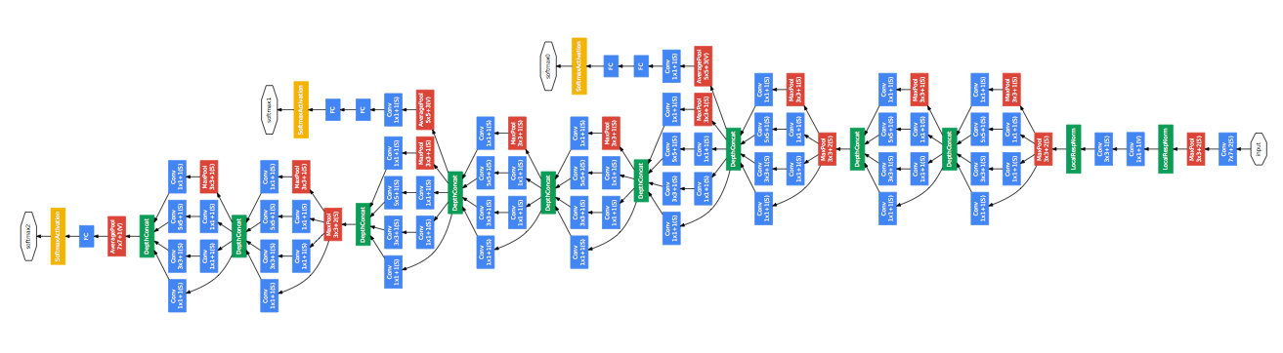
Deep Learning Networks

Slide 31
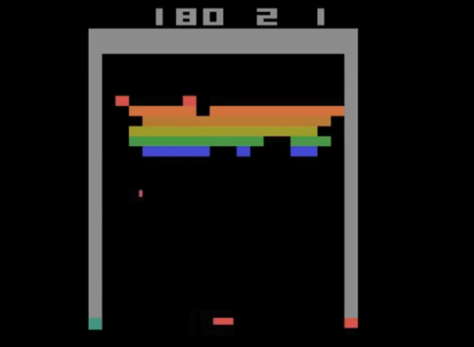
Reinforcement Learning
Learns to make decisions
Prescriptive Analytics
Must operate in an interactive environment

Slide 32

AI
Bigger challenges
More complexity
More engineering

Slide 33
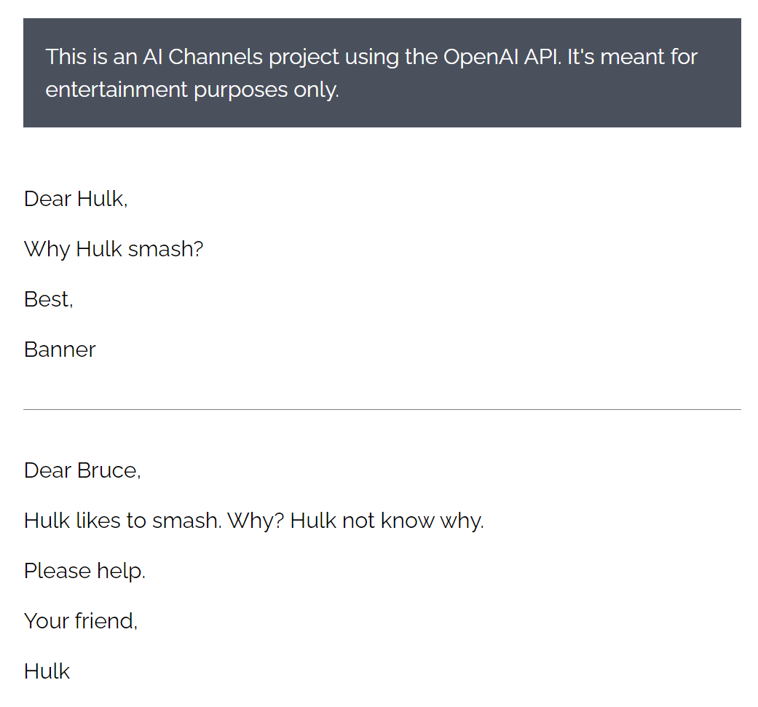
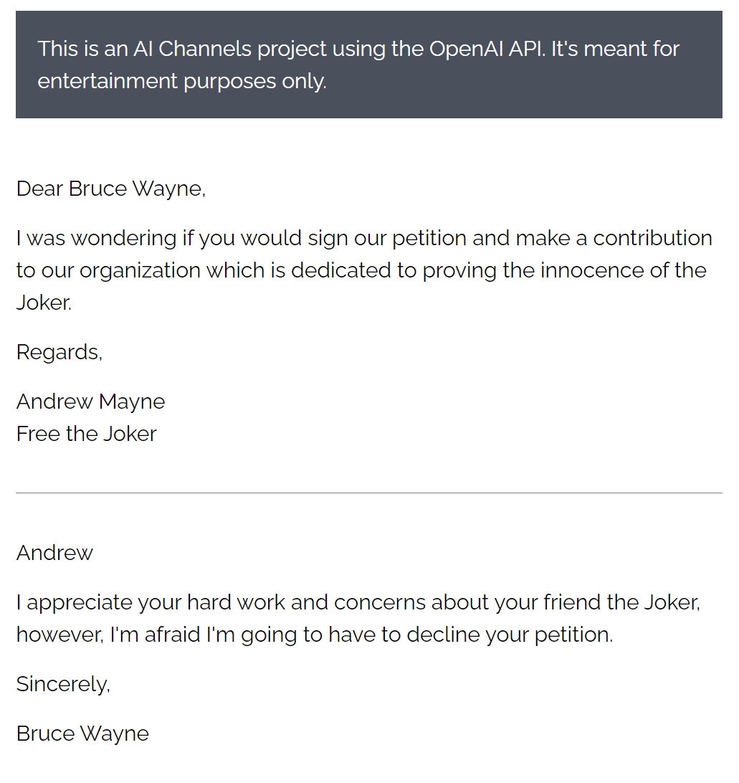
GPT-3

Slide 34
Summary
Data Mining/Machine Learning
Like statistics with more data
Use computers, automation
Types of Machine Learning
Unsupervised
Supervised
Classification
Regression
Reinforcement Learning
AI

Slide 35
Quiz
bit.ly/3BD5kQr
>80% receive an Elon certificate of completion

